Slide 1
EE359 – Lecture 5 Outline
Announcements:
  Discussion section in Redwg 19.
Review of Last Lecture
Narrowband Fading Model
In-Phase and Quad Signal Components
Auto and Crosscorrelation
Signal Envelope Distributions

Slide 2


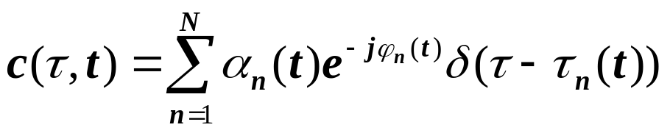
Review of Last Lecture
Model Parameters from Empirical Data
  Obtain path loss model from MMSE curve fit
  Obtain STD of data relative to path loss model
Random Multipath Model
Time Varying Channel Impulse Response
Random (large) number of components
-Random delays/gains/doppler on each

Slide 3
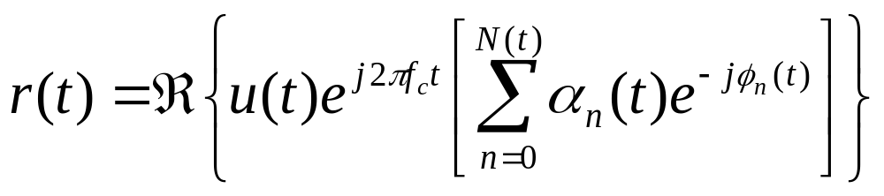
Narrowband Model
Assume delay spread max_{m,n}|τ_{n}(t)-τ_{m}(t)|<<1/B
Then u(t)≈u(t-τ).
Received signal given by
No signal distortion (spreading in time)
Multipath affects complex scale factor in brackets.
Characterize scale factor by setting u(t)=e^{jφ0}

Slide 4
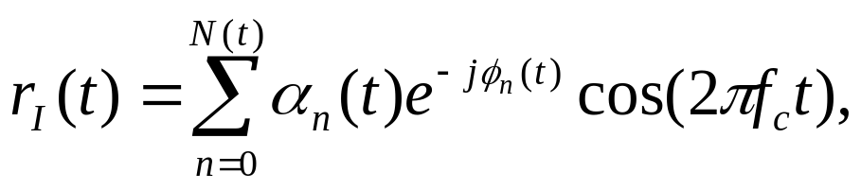
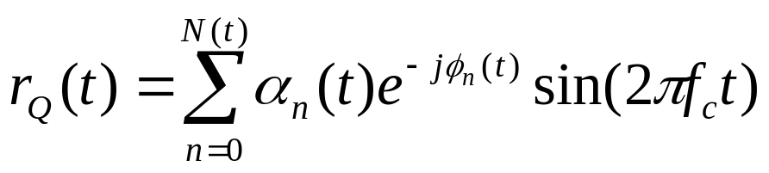
In-Phase and Quadrature under CLT Approximation
In phase and quadrature signal components:
For N(t) large, r_{I}(t) and r_{Q}(t) jointly Gaussian by CLT (sum of large # of random vars).
Received signal characterized by its mean, autocorrelation, and cross correlation.
If ϕ_{n}(t) uniform, the in-phase/quad components are mean zero, indep., and stationary.

Slide 5
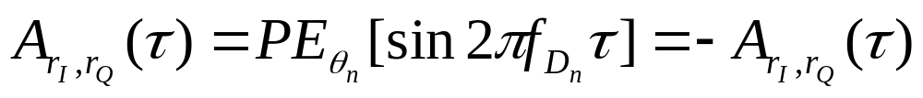
Auto and Cross Correlation
Assume φ_{n}~U[0,2π]
Recall that θ_{n} is the multipath arrival angle
Autocorrelation of inphase/quad signal is
Cross Correlation of inphase/quad signal is
Autocorrelation of received signal is

Slide 6
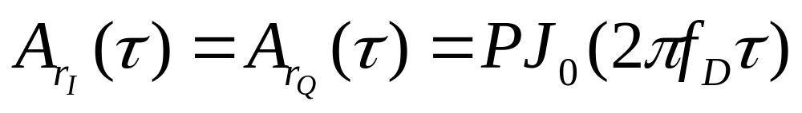
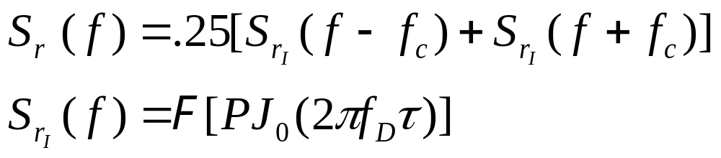
Uniform AOAs
Under uniform scattering, in phase and quad comps have no cross correlation and autocorrelation is
The PSD of received signal is
Decorrelates over roughly half a wavelength
S_{r}(f)
Used to generate simulation values
f_{c}-f_{D}
f_{c}
f_{c}+f_{D}

Slide 7
Signal Envelope Distribution
CLT approx. leads to Rayleigh distribution (power is exponential)
When LOS component present, Ricean distribution is used
Measurements support Nakagami distribution in some environments
  Similar to Ricean, but models “worse than Rayleigh”
  Lends itself better to closed form BER expressions

Slide 8
Main Points
Narrowband model has in-phase and quad. comps that are zero-mean stationary Gaussian processes
  Auto and cross correlation depends on AOAs of multipath
Uniform scattering makes autocorrelation of inphase and quad follow Bessel function
  Signal components decorrelated over half wavelength
  Cross correlation is zero (in-phase/quadrature indep.)
Fading distribution depends on environment
  Rayleigh, Ricean, and Nakagami all common

